Slide 1
Types of Lava

Slide 2
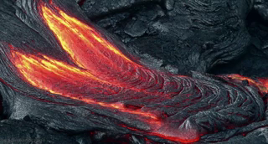
By the end of this fiery journey, you should be able to:
1. | Compare felsic and mafic lava compositions;
2. | Explain how the silica content of lava relates to how explosive it is.

Slide 3
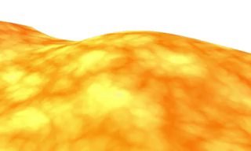
Lava is molten rock, formerly magma, that has been spewed out by a volcano.
Once it is exposed on the Earth's surface, lava begins to cool down and crystallise. This happens because Earth's atmosphere is very cold compared to the intense heat inside a volcano!
As it cools, the lava solidifies to form volcanic rocks.
The exact minerals and rocks that are produced depend on the chemicals inside the lava.

Slide 4
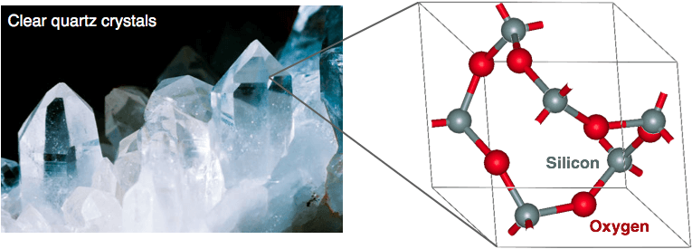
All rocks are made up of minerals. One of the most common minerals of all is silica; you may know it as quartz.
Quartz has the chemical formula SiO_{2​} - it contains one part silicon to two parts oxygen.
It contains the same elements as glass, and quartz crystals even look like glass! However, quartz and glass have different molecular structures.

Slide 5
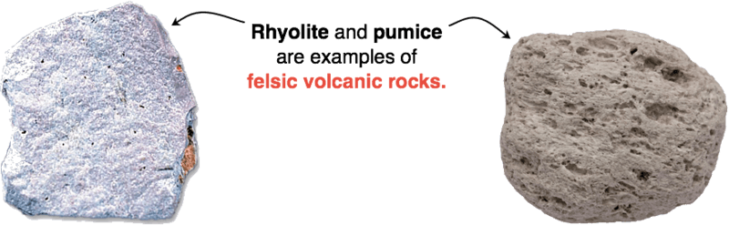
The amount of silica inside lava has a huge impact on how it erupts and the rocks it can form.
Felsic lava is rich in minerals like feldspar and quartz. Feldspar contains a high proportion of silica, and quartz is pure silica!
Rocks formed from felsic lava are at least 65% silica in some form. They tend to be pale in colour and less dense than other volcanic rock types.

Slide 6
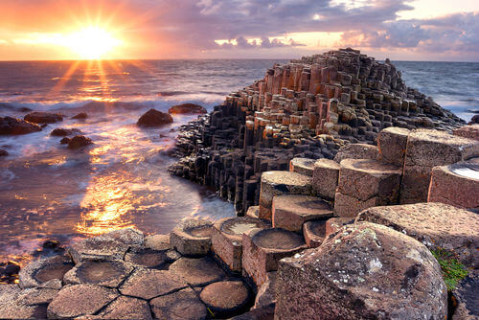
By contrast, mafic lava crystallises to form darkly coloured minerals such as olivine, biotite and pyroxene.
Mafic volcanic rocks tend to be dark in colour. They contain a low proportion of silica compared to felsic rocks: between 45% and 55% by weight.
The most common mafic igneous rock is basalt, which makes up the spectacular Giant's Causeway in Northern Ireland:

Slide 7
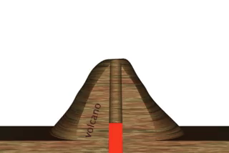
The properties of lava affect how it erupts from a volcano.
Some types of lava ooze quietly along the ground, such as the famous pahoehoe flows of Hawaii. Here the lava may have a temperature of 1200∘C, but it moves slower than walking speed.
Other types of lava are rather less quiet and create almighty tremors and explosions!

Slide 8
Felsic lava contains high amounts of silica, which makes it very viscous.
The term 'viscous' describes liquids that are very thick, like syrup. The more silica in a sample of lava, the more slowly the lava flows.
Viscous lava is able to trap gases inside, including steam and carbon dioxide. As molten rock rises through Earth's surface, those gases can expand and burst free, causing an explosive eruption!

Slide 9
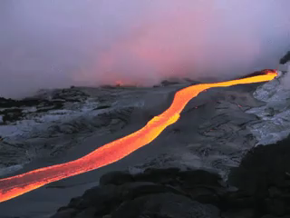
Mafic lava - the type that forms basalt - contains smaller amounts of silica.
This means that mafic lava is less viscous and flows more easily than felsic lava. As we mentioned before, it's still usually slower than walking speed!
It is also less likely to trap gases. Therefore, when mafic lava erupts it is usually not explosive.

Slide 10
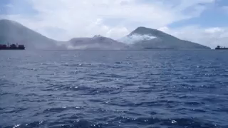
The Volcanic Explosivity Index (VEI) is used to indicate how explosive an eruption is.
Volcanoes spew out more than just lava; they also send gases, rock fragments and ash high into the atmosphere!
The VEI takes into account the amount of material erupted, and the height of the ash cloud that forms. The more explosive an eruption, the more it shoots skyward.

Slide 11
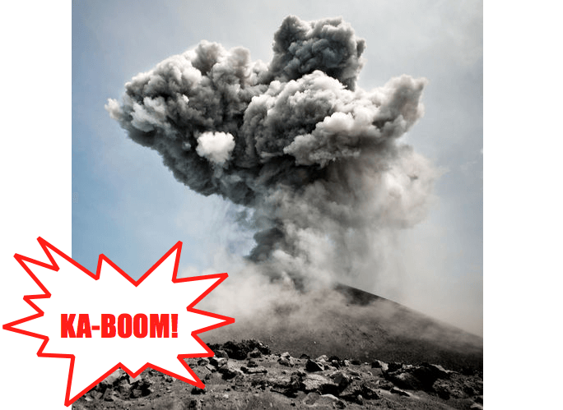
The minimum value on the VEI scale is 0, which means 'non-explosive'. However, there is no defined maximum value of explosivity.
The highest VEI level yet reached was 8. Eruptions of this scale are caused by 'supervolcanoes' such as Yellowstone in the USA, or Toba in Indonesia.
An Icelandic volcano known as Eyjafjallajökull underwent an eruption in 2010 that registered at 4 on the VEI scale. It was nowhere near as powerful as an eruption from Yellowstone or Toba, but the ash from this eruption was still powerful enough to shut down air traffic over Europe!

